Slide 1
Team Doldit
presents

Slide 2

DolditMan

Slide 3

Arcade game for the running man
The point of the game is to avoid obstacles with jumping.

Slide 4

Game controls
Left Arrow – move left
Right Arrow – move right
Space – jump

Slide 5
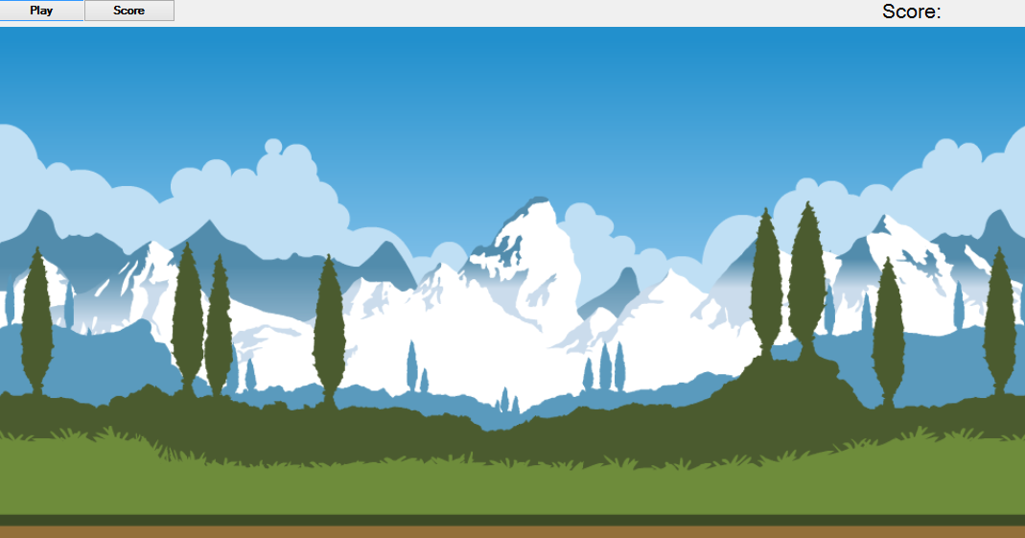
Game view

Slide 6



Team members
Georgi Matsov
https://github.com/bewolf
Martin Papazov https://github.com/MartinPapazov
https://github.com/KirilKazakov
https://github.com/ZdravkoGeorgiev
https://github.com/iliyan88

